Slide 1

Überblick Microsoft Cloud Adoption Framework
Govern

Slide 2
Plan
An iterative process that supports your business … as it evolves
Govern
Manage
Define strategy
Adopt
Ready

Slide 3

Why is governance important?
Who is responsible for monitoring? support? And operations?
Which services should be migrated to Azure?
Transformation
Risk mitigation
What roles & responsibilities must be defined?
What security measures should I consider?
What are the core processes needed for service management?
How do I ensure a balance between innovation, cost and agility?
Maintaining full compliance
Creating better cost visibility and control
Improving security posture
Being agile—to support scale
What organizational changes are needed?
What key capabilities I must develop?
Azure governance building blocks?

Slide 4
Govern

Slide 5
Govern
Define strategy
Plan
Ready
Adopt
Adopting the cloud is a journey, not a destination. Along the way, there are clear milestones and tangible business benefits. The final state of cloud adoption is unknown when a company begins the journey. Cloud governance creates guardrails that keep the company on a safe path throughout the journey.
Govern
Manage
Establish your methodology:
Establish a basic understanding of the methodology that drives cloud governance in the Cloud Adoption Framework to begin thinking through the end state solution.
Use the governance benchmark tool:
Assess your current state and future state to establish a vision for applying the framework.
Establish an initial governance foundation:
Begin your governance journey with a small, easily implemented set of governance tools. This initial governance foundation is called a minimum viable product (MVP).
Improve your initial governance foundation:
Throughout implementation of the cloud adoption plan, iteratively add governance controls to address tangible risks as you progress toward the end state.

Slide 6


Governance model
Envision an end state – and incrementally build trust and confidence.
Govern
Define corporate policy
Business risks
Document evolving business risks and the business’ tolerance for risk, based on data classification and application criticality
Policy & compliance
Convert risk decisions into policy statements to establish cloud adoption boundaries
Process
Establish processes to monitor violations and adherence to corporate policies.
Five disciplines of cloud governance
Cost management
Evaluate & monitor costs, limit IT spend, scale to meet need, create cost accountability
Security baseline
Ensure compliance with IT security requirements by applying a security baseline to all adoption efforts
Resource consistency
Ensure consistency in resource configuration. Enforce practices for on-boarding, recovery, and discoverability
Identity baseline
Ensure the baseline for identity and access are enforced by consistently applying role definitions and assignments
Deployment acceleration
Accelerate deployment through centralization, consistency, and standardization across deployment templates
Governance funnels corporate policy changes into five actionable disciplines –
enabling your organization to modernize and reach business goals.
https://aka.ms/adopt/Gov

Slide 7
Governance – develops and evolves corporate policies for:
Resource consistency and management
Security baseline
Identity baseline
Cost management
Deployment acceleration
Cloud governance team
A team consisting of cloud architects, legal, security and/or HR & Finance develops and enforces these disciplines across your organization to ensure governance consistency.

Slide 8
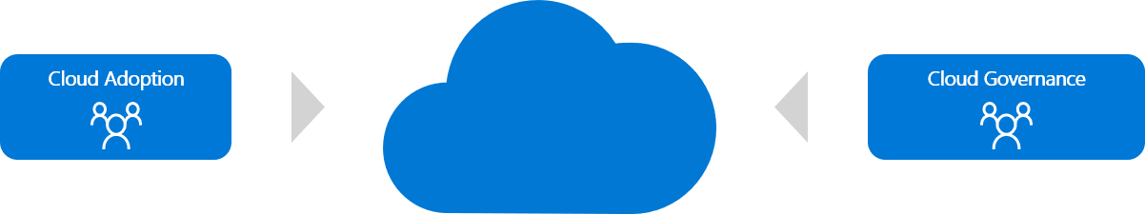
Cloud governance team

Slide 9
Governance as actionable model

Slide 10

Cost management
Establish controls and processes to ensure proper allocation of cost across business units, implement cost guardrails, and analyze the cost of applications.
Azure tools and services
Define
Enterprise Enrollment Hierarchy Process and RACI Azure Cost Management Budgets and Alerts + RACI
Cost Management RBAC Model
Define Cost Management Policies
Tagging
Allowed VM SKUs
Allowed Storage SKUs
Allowed Networking SKUs
Allowed Database SKUs
Azure Policy
Azure Cost Management PBI Application in Azure Marketplace
Azure Advisor
Azure Portal
Azure EA Content Pack

Slide 11
Security baseline
Establish policies to protect your network, assets, and data –
residing on cloud provider platform(s).
Document risks, business tolerance, and mitigation strategies related to the security of:
Data and assets: develop clear, simple, and well-communicated guidelines to identify, protect, and monitor the most important data assets
Network: control and monitor any allowed communication between on-premises environment and cloud workloads.
Azure tools and services
Azure Policy
Azure Security Center
Azure Sentinel
Subscription Design
Encryption
Hybrid Identity
Azure Networking
Azure Automation
Implement these best practices for corporate policy:
Network requirements: on-premises networks must be secured against potential unauthorized access from cloud-based resources.
Hybrid identity strategies: a key factor in structuring cloud-based identity services is the level of integration required with existing on-premises identity infrastructure.
Encryption: encryption mechanisms vary in cost and complexity, and both technical and policy requirements and can influence decisions on how encryption is applied and how to store and manage critical secrets and keys
Security Baseline policies: processes that manage updates to security policy based on inputs from stakeholders. (e.g., initial risk assessment and planning, deployment planning and testing, and quarterly review and planning)

Slide 12
Resource consistency
Implement the foundation for governance best practices –
with correct resource organization.
Azure tools and services
Define Azure Management Groups & Subscriptions model and RACI
To reflect security, operations and business/accounting hierarchies
To group similar resources into logical collections
Define resource consistency roles & responsibilities
To further group applications or workloads into deployment and operations units
Azure Policy
Azure Monitor
Azure Advisor
Resource Manager Templates
Resource Graph
Management Groups
Define Resource Consistency Policies
Naming Conventions
Tagging
Allowed Locations
Allowed Resource Types
Allowed Extensions
Auditing

Slide 13
Identity baseline
Protect your data and assets in the cloud –
implementing identity management and access control.
Define Azure RBAC Model
Using RBAC can segregate duties within a team and grant only the amount of access to users that they need to perform their jobs. Instead of giving everybody unrestricted permissions in an Azure subscription or resources, only certain actions with narrow scope can be allowed.
Azure tools and services
Define Azure Access Management Process and RACI
Several options are available for managing identity in a cloud environment which vary in cost and complexity.
A key factor in structuring your cloud-based identity services is the level of integration required with existing on-premises identity infrastructure.
RBAC
Azure AD
Azure AD B2B
Azure AD B2C
Directory Federation
Directory Replication
Operationalize Azure Privileged Identity Management
Cloud-based identity management is an iterative process.

Slide 14
Deployment acceleration
Establish policies to govern asset configurations or deployments –manual, or automated through DevOps best practices.
The DevOps practices in this discipline include:
Infrastructure as code
Stand up environments in the fastest means possible.
Remove the human element and reliably and repeatable deploy every time.
Improve environment visibility and improve developer efficiency
Store infrastructure definitions alongside application code.
Continuous integration and continuous deployment
Accelerate delivery through automation
Simple and easy to use
Global community for actions
Azure services that enable deployment acceleration include Azure Blueprints
Deploy and update cloud environments in a repeatable manner using composable artifacts
Azure tools and services
Resource Manager Templates
Azure PowerShell
Azure CLI
Azure Policy
Resource Grouping & Tagging
Azure DevOps
Github – Azure Github Actions
Azure Automation

Slide 15
Define your initial governance state – leverage the Governance benchmark assessment

Slide 16
Govern
Define strategy
Plan
Ready
Adopt
Adopting the cloud is a journey, not a destination. Along the way, there are clear milestones and tangible business benefits. The final state of cloud adoption is unknown when a company begins the journey. Cloud governance creates guardrails that keep the company on a safe path throughout the journey.
Govern
Manage
Establish your methodology:
Establish a basic understanding of the methodology that drives cloud governance in the Cloud Adoption Framework to begin thinking through the end state solution.
Use the governance benchmark tool:
Assess your current state and future state to establish a vision for applying the framework.
Establish an initial governance foundation:
Begin your governance journey with a small, easily implemented set of governance tools. This initial governance foundation is called a minimum viable product (MVP).
Improve your initial governance foundation:
Throughout implementation of the cloud adoption plan, iteratively add governance controls to address tangible risks as you progress toward the end state.

Slide 17

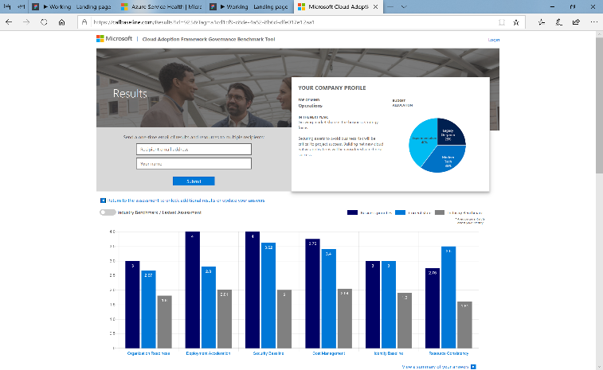
Benchmark your governance state
Make governance actionable with processes and policies. Use the Governance benchmark tool.
Establish a governance baseline and recommended starting-point
Understand gaps between your desired and current governance state, using the Cloud Adoption Framework.
Remove blockers with curated guidance on how to build a proper Governance foundation.
https://cafbaseline.com/

Slide 18
Take action and set up your initial governance foundation

Slide 19
Govern
Define strategy
Plan
Ready
Adopt
Adopting the cloud is a journey, not a destination. Along the way, there are clear milestones and tangible business benefits. The final state of cloud adoption is unknown when a company begins the journey. Cloud governance creates guardrails that keep the company on a safe path throughout the journey.
Govern
Manage
Establish your methodology:
Establish a basic understanding of the methodology that drives cloud governance in the Cloud Adoption Framework to begin thinking through the end state solution.
Use the governance benchmark tool:
Assess your current state and future state to establish a vision for applying the framework.
Establish an initial governance foundation:
Begin your governance journey with a small, easily implemented set of governance tools. This initial governance foundation is called a minimum viable product (MVP).
Improve your initial governance foundation:
Throughout implementation of the cloud adoption plan, iteratively add governance controls to address tangible risks as you progress toward the end state.

Slide 20
Build the governance MVP
Standard enterprise | Complex enterprise
Customers or staff reside largely in one geography | Customers or staff reside in multiple geographies or require sovereign clouds
Business units share a common IT infrastructure | Multiple business units that do not share a common IT infrastructure
Single IT budget | Budget allocated across business units and currencies
Capital expense-driven investments are planned yearly and usually cover only basic maintenance | Capital expense-driven investments are planned yearly; often include maintenance and refresh cycles of 3-5 years
Datacenter or third-party hosting providers with fewer than five datacenters | Datacenter or third-party hosting providers with more than five datacenters
Networking includes no WAN; or 1-2 WAN providers | Networking includes complex network or global WAN
Identity is a single forest, single domain | Identity consists of multiple forests, multiple domains
Cost Management (cloud accounting) showback model – billing is centralized through IT | Cost Management (cloud accounting) chargeback model – billing can be distributed through IT procurement
Security Baseline – protected data: company financial data and IP. Limited customer data. No third-party compliance requirements. | Security Baseline (protected data) – Multiple collections of customers' financial and personal data

Slide 21
Making Governance Actionable with Azure Native Tools
Cloud Native Tools
Cost Management
Security Baseline
Identity Baseline
Resource Consistency
Deployment Acceleration
Azure Blueprints
Azure Policy
Azure Cost Management
Azure Advisor
Azure Blueprints
Azure Policy
Azure Security Center
Azure Sentinel
Threat Protection
Azure Blueprints
Azure RBAC
Azure AD
Azure AD B2B
Azure AD B2C
Directory Federation
Directory Replication
Azure Blueprints
Azure Policy
Azure Monitor
Change Tracking
DSC
Update Management
Automation
Azure Blueprints
Azure Policy
Resource Tagging
ARM Templates
Azure DevOps
Azure Site Recovery
Azure Backup
Azure Automation

Slide 22
Azure Policies
Ensure data sovereignty by restricting, enforcing, or auditing certain actions
{
"if" : {
<condition> | <logical operator>
},
"then" : {
"effect" : "deny | audit | append | deployIfNotExists“
}
}
Finance/Business
How can I be notified when costly resources are created?
How can I ensure that new resources are identified with common information like “Cost Center?”
Technology Pro
How can ensure my subscriptions have only allowed resources?
Can I make sure developers follow our established naming conventions?
Security/Risk Mgmt.
How do I ensure we don’t violate data sovereignty rules?
How can I find out when resources are created so I can verify they follow our Security Policies?
Link to Azure Resource Manager policy introduction: https://azure.microsoft.com/en-us/documentation/articles/resource-manager-policy/

Slide 23
Govern
Define strategy
Plan
Ready
Adopt
Adopting the cloud is a journey, not a destination. Along the way, there are clear milestones and tangible business benefits. The final state of cloud adoption is unknown when a company begins the journey. Cloud governance creates guardrails that keep the company on a safe path throughout the journey.
Govern
Manage
Establish your methodology:
Establish a basic understanding of the methodology that drives cloud governance in the Cloud Adoption Framework to begin thinking through the end state solution.
Use the governance benchmark tool:
Assess your current state and future state to establish a vision for applying the framework.
Establish an initial governance foundation:
Begin your governance journey with a small, easily implemented set of governance tools. This initial governance foundation is called a minimum viable product (MVP).
Improve your initial governance foundation:
Throughout implementation of the cloud adoption plan, iteratively add governance controls to address tangible risks as you progress toward the end state.

Slide 24

Executing incremental governance
Governance MVP
Establish a foundation that can quickly evolve as cloud adoption and cloud governance mature. Mitigate tangible risks identified in the cloud adoption plan.
Governance MVP
Identity strategy
Security management discipline evolves
Resource management discipline evolves
Cost management discipline evolves
Network & encryption strategy
Update corporate policy… Implement with configuration management changes
Update corporate policy… Implement with configuration management changes
Update corporate policy… Implement with configuration management changes
Configuration strategy & corporate policy implementation
Risk Evolutions
The risk profile will change as you plan additional iterations of cloud adoption. The cloud governance team monitors those adoption plans to identify risks and evolve corporate policy statements.
Risk:
Protected Data
Risk:
Critical Apps
Risk:
Cost
Cloud Adoption Adoption timeline will trigger risks along the journey

Slide 25
Sample policies: Cost management
Modify CostCenter Tag & its value from Resource Group
Modify CostCenter Tag to Resource Groups
For tracking purposes, all assets must be assigned to an application owner within one of the core business functions.
When cost concerns arise, additional governance requirements will be established with the finance team.
Allowed Azure Region for Resources and Resource Groups​
Allowed Azure VM SKUs

Slide 26
Sample policies: Security baseline
All deployed assets must be categorized by criticality and data classification.
All protected data must be encrypted when at rest.
Network subnets containing protected data must be isolated from any other subnets. Network traffic between protected data subnets is to be audited regularly.
All connections between the on-premises and cloud networks must take place either through a secure encrypted VPN connection or a dedicated private WAN link.
No public facing web site backed by IaaS should be exposed to the internet without DDoS.
Governance tooling must audit and enforce network configuration requirements defined by the Security Baseline team.
Trends and potential exploits that could affect cloud deployments should be reviewed regularly by the security team to provide updates to Security Baseline tooling used in the cloud..

Slide 27
Sample policies: Resource consistency
All deployed assets must be categorized by criticality and data classification.
Subnets containing mission-critical applications must be protected by a firewall solution capable of detecting intrusions and responding to attacks.
Governance tooling must audit and enforce network configuration requirements defined by the Security Management team.
Governance tooling must validate that all assets related to mission-critical apps or protected data are included in monitoring for resource depletion and optimization.
Governance tooling must validate that the appropriate level of logging data is being collected for all mission-critical applications or protected data.
Governance process must validate that backup, recovery, and SLA adherence are properly implemented for mission-critical applications and protected data.

Slide 28
Sample policies: Identity baseline
All assets deployed to the cloud should be controlled using identities and roles approved by current governance policies.
A least-privilege access model will be applied to any resources involved in mission-critical applications or protected data.
Elevated permissions should be an exception, and any such exceptions must be recorded with the cloud governance team. Exceptions will be audited regularly.
All groups in the on-premises Active Directory infrastructure that have elevated privileges should be mapped to an approved RBAC role.
All accounts are required to sign in to secured resources using a multi-factor authentication method.
Deployment of any applications that require customer authentication must use an approved identity provider that is compatible with the primary identity provider for internal users.

Slide 29
Sample policies: Deployment acceleration
All assets deployed to the cloud should be deployed using templates or automation scripts whenever possible.
Key metrics and diagnostics measures will be identified for all production systems and components.
Operations will consider using monitoring and diagnostic tools in nonproduction environments such as Staging and QA to identify system issues before they occur in the production environment.
Cloud governance processes must include monthly review with configuration management teams to identify malicious actors or usage patterns that should be prevented by cloud asset configuration.

